Slide 1
JDemetra+
Overview

Slide 2
Outline
Objectives of JDemetra+ (JD+)
General
For seasonal adjustment (SA)
What is really JD+ ?
Architecture, design
Seasonal adjustment framework
Methods, design, examples
Final remarks

Slide 3
1.1 General Objectives
Providing algorithms for the production/analysis of [official] statistics
Time series (JD+ 2.x: from monthly to yearly, JD+ 3.0: any)
Algorithms for
Seasonal adjustment, business cycle analysis
Benchmarking, temporal disaggregation
Modelling (nowcasting, forecasting, estimation of missing values, outliers detection…)
Reusable modules, compatible with common IT infrastructure
Java, WEB services, R...
Designed for the whole statistical process
From research to bulk production (flexible, high-performance)
Maintainable
Open source solution

Slide 4
1.2 Objectives for SA
Java implementation of the leading algorithms
Tramo-Seats, X12-ARIMA, structural time series, STL...
Flexible design
Easier modifications of the core engines
Developments of additional tools/algorithms
Challenge
Keeping
similar results
high performances
with
flexible (more general) design and algorithms
slower technical solution

Slide 5
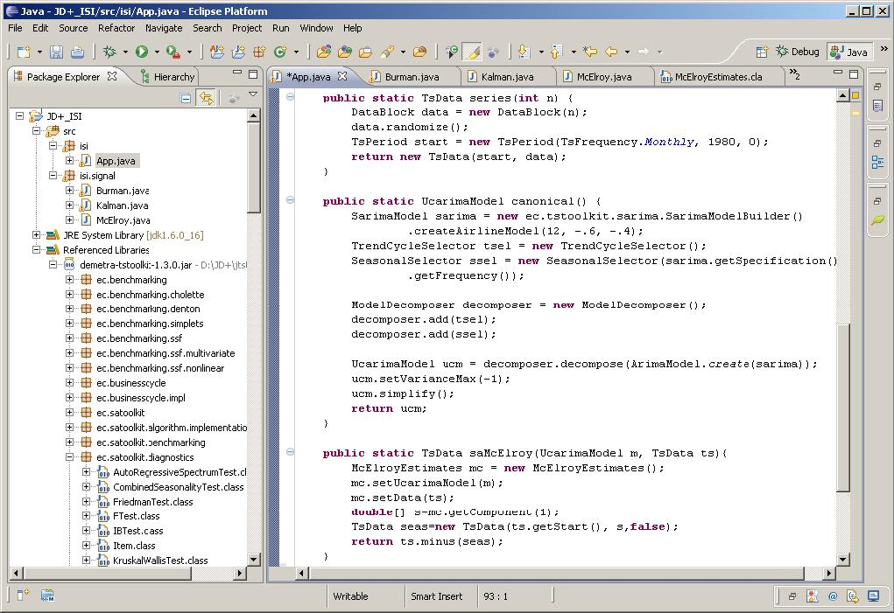
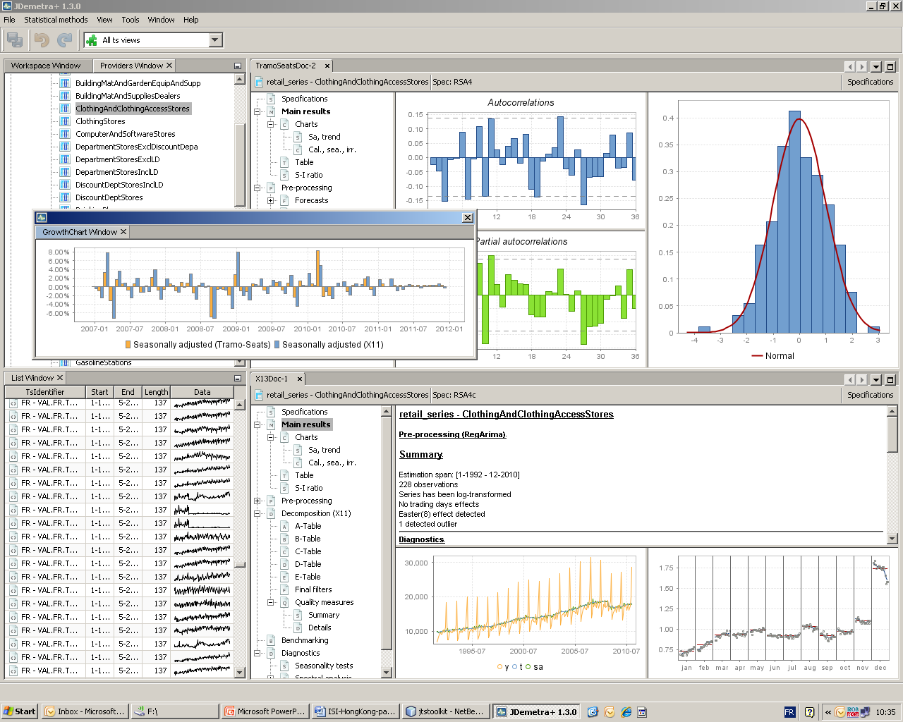
2 What is JD+ (I) ?
Advanced Java toolkit for time series (SA) processing (IT-teams, researchers)
Rich graphical application (end-users)

Slide 6
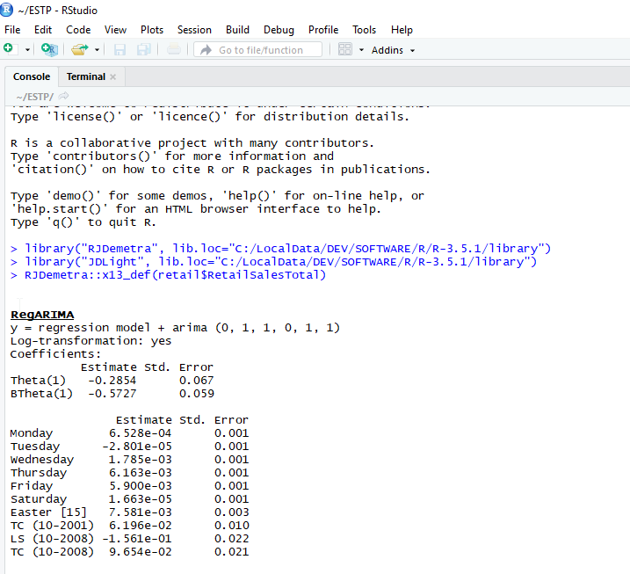
2 What is JD+ (II) ?
Call from R

Slide 7
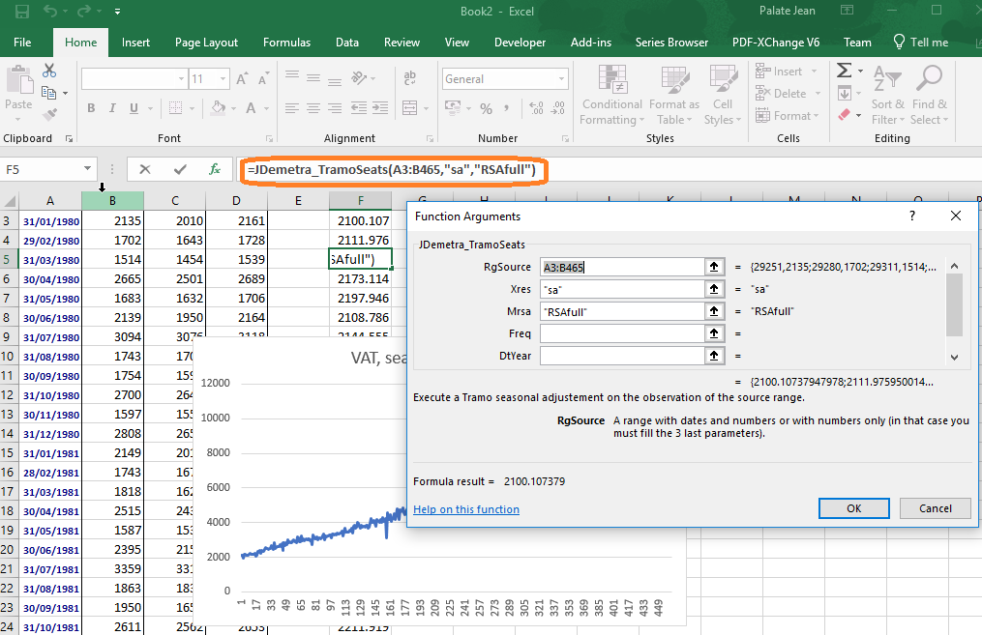
2 What is JD+ (III) ?
Use of the WEB service

Slide 8
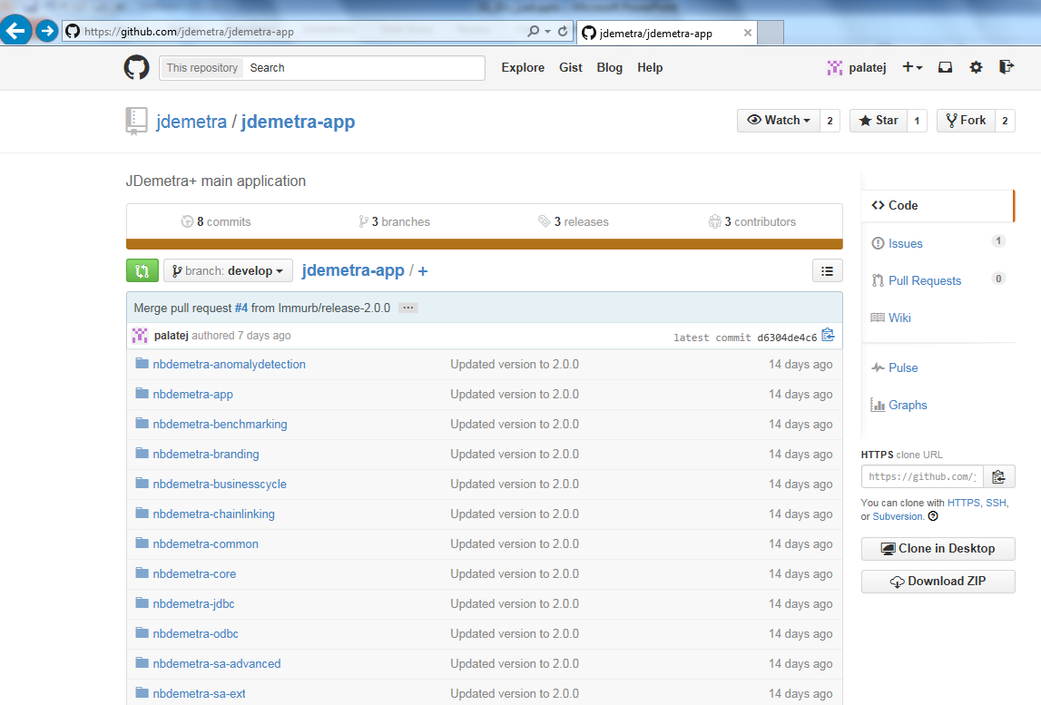
2 What is JD+ ? (IV)
Open Source project
(EUPL license)
Supported by Eurostat
Developers:
NBB
Bundesbank
...
Originally based on:
Tramo-Seats (BDE)
X12-Arima (USCB)
https://github.com/jdemetra

Slide 9
3.1 Architecture
JTsToolkit
Core algorithms
Cruncher, R WEB service
In house developments
External
packages
Peripheral modules
Jdemetra-core
Jdemetra-app
NetBeans
JDemetra+ plug-ins
Third party
plug-ins

Slide 10
3.2 Algorithmic libraries (jtstoolkit…)
Basic data handling
Basic econometrics
Matrix computation
Regarima modelling
Tramo
Benchmarking, temporal disaggregation
Complex, polynomials
X12 preprocessing
Structural models...
Linear filters
Arima, Ucarima
X11
VAR,
Dynamic factor model…
Function optimization
Seats
Basic statistics
State space framework
Utilities...
Time series, calendars, regression variables...

Slide 11

4.1 SA methods
$$Y=T+S+I$$
Non parametric
Parametric
Stochastic
Deterministic
LOESS
Moving averages
ARIMA
models
Structural models
Local regressions
STL
X11
Canonical decomposition
SEATS
BV4
X12-ARIMA
UCARIMA
models
Kalman smoother
WK filters
Ladiray D. and Quenneville B. [1999], Comprendre la methode X11

Slide 12
4.1 SA methods
$$Y=T+S+I$$
Non parametric
Parametric
Stochastic
Deterministic
JD+J
LO(W)ESS
Moving averages
ARIMA
models
Structural models
Local regressions
STL
X11
Canonical decomposition
SEATS
BV4
X12-ARIMA
UCARIMA
models
Kalman smoother
WK filters

Slide 13
4.2 OO-Design of JD+
Conceptual approach
Time series
SA decomposition
Linear filters
Arima models
…
Generic algorithms
Kalman filters
WK filters
RegARIMA estimation
…
Common tools
Presentation tools
Diagnostics
…
Implementation of specific SA/modelling algorithms
X11, X12
Tramo-Seats
…

Slide 14
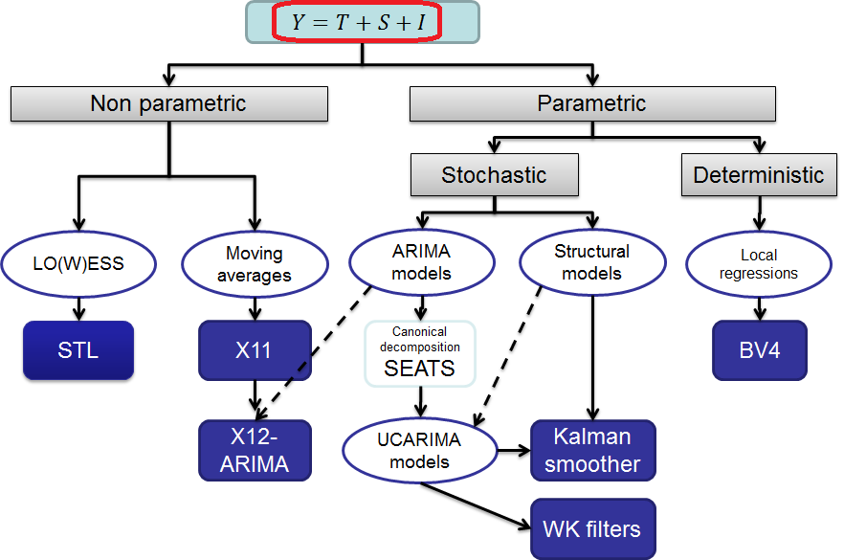
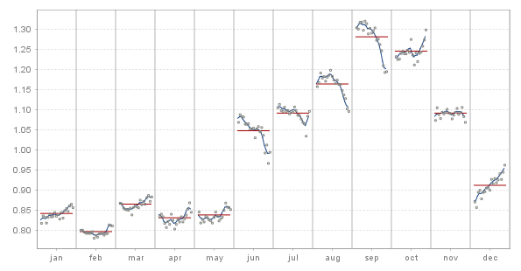
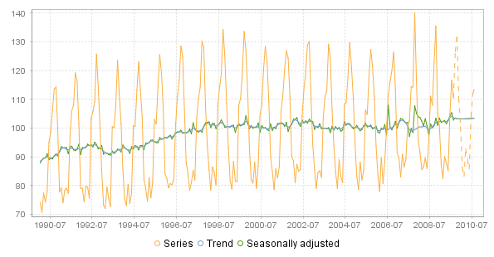
4.3 Common presentation tools
S-I ratios
Main series

Slide 15
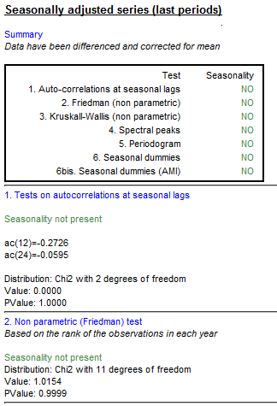
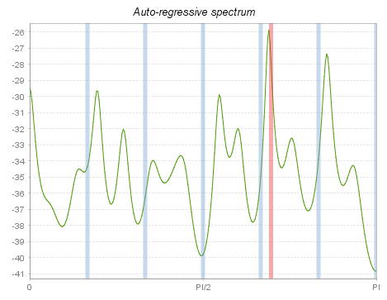
4.4 Common (non parametric) diagnostics
Seasonality tests
Spectral analysis
Sliding spans,
Revisions history
…

Slide 16
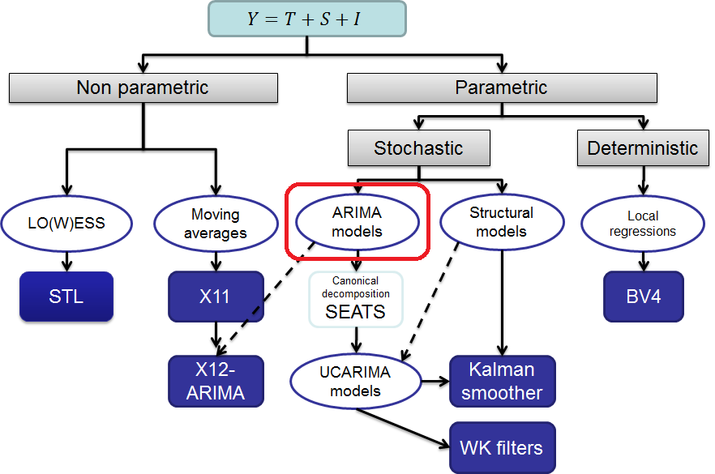
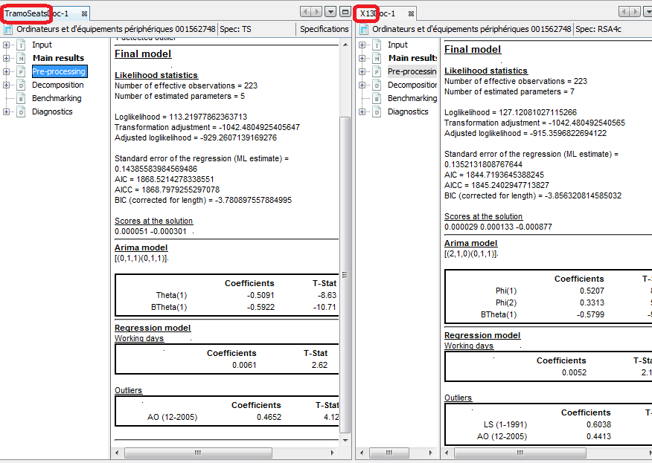
4.5 Common regression model
RegArima (Tramo, X12-ARIMA)

Slide 17
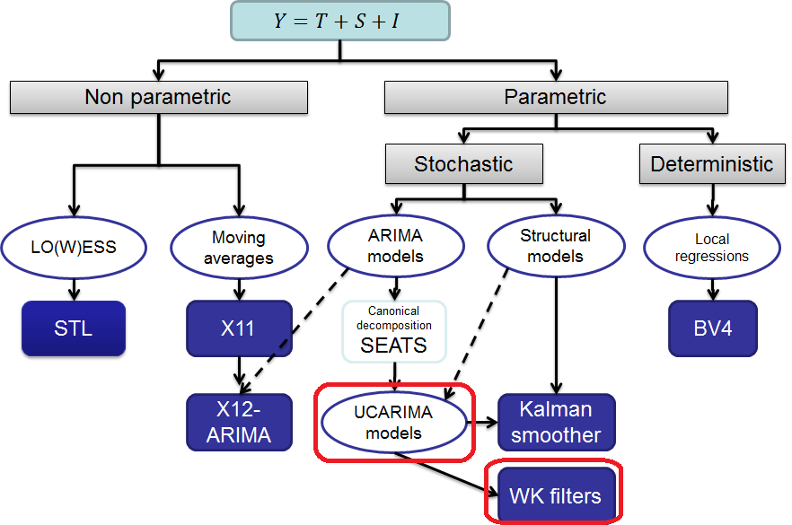
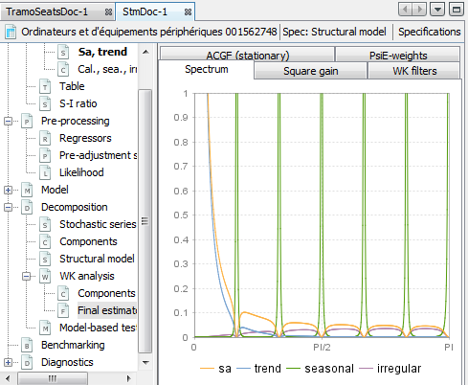
4.6 Common estimation methods
WK analysis (SEATS)
UCARIMA components
WK filters (Burman)
Kalman smoother
…

Slide 18
5. Next challenges (JD+ 3.0…)
Basic structures
Generic time series
High-frequency…
Time series methods for official statistics
Integrated (« two-steps ») SA processing
Common REGARIMA
Different filters (X11, SEATS…)
Advanced SA topics
Structural models…
Benchmarking, temporal disaggregation
“JEcotrim” (in connection with the new guidelines)
Rapid estimates
Nowcasting…

Slide 19
5. Next challenges (cont.)
Documentation
Researchers: statistical methods
Developers: API
Users: graphical interfaces, command line tools
Systematic connection with R
See later

